Slide 1
Chapter 9
Genetic Algorithms

Slide 2
Genetic Algorithms
Based upon biological evolution
Generate successor hypothesis based upon repeated mutations
Acts as a randomized parallel beam search through hypothesis space

Slide 3
Popularity of GA’s
Evolution is a successful, robust method for adaptation in biological systems
GA’s can search complex spaces.
Easily parallelized

Slide 4
Genetic Algorithms
Each iteration all members of a population are evaluated by the fitness function.
A new population is generated by probabilistically selecting the most fit individuals.
Some of the individuals are changed by operations Mutation and Crossover.

Slide 5
GA Terms
Population: A group of individual “genes”.
  Each forms a hypothesis for a solution to a given problem.
Fitness Function: A function that assigns an evaluation score to a hypothesis.
Fitness Threshold: A fitness that determines when to terminate.
p: The size of the population of hypothesis.
r : The fraction of population to be used in crossover
m:The mutation rate (fraction of population to mutate)

Slide 6
The Algorithm
Initialize Population: P := p random hypothesis
Evaluate: compute fitness for each individual in P
while max fitness is < FitnessThreshold do
  Create New Generation P_{S}
    Select (1-r)p hypothesis from P to P_{S}
    Crossover : select rp hypothesis to crossover.
    Mutate: Select m percent of hypothesis from P_{S} to mutate
    Update: P := P_{S}
    Evaluate : Compute fitness for each individual
    in P.

Slide 7
Crossover
Two parent hypothesis are chosen probabilistically from the population based upon their fitness
The parent hypothesis combine to form two child hypothesis.
The child hypothesis are added to the population

Slide 8
Crossover Details
Crossover operator
  produces two new offspring from a parent
Crossover bit mask
  determines which parent will contribute to which position in the string

Slide 9
Crossover Types
Single-point crossover
  parents are “cut” at one point and swap half of the bit string with the other parent
Two-point crossover
  parents are cut at two points
  often outperforms single-point crossover
Uniform Crossover
  each bit is sampled randomly from each parent
  often looses coherence in hypothesis

Slide 10
Crossover Types
Single point:
11101001000
11101010101
11111000000
00001010101
00001001000
Two-point:
11101001000
11001011000
00111110000
00001010101
00101000101
Uniform:
11101001000
10001000100
10011010011
00001010101
01101011001
Mutation:
11101001000
11100001000

Slide 11
Mutation
A number of hypothesis are chosen randomly from the population.
Each of these hypothesis are randomly mutated to form slightly different hypothesis.
The mutated hypothesis replace the original hypothesis.

Slide 12
Fitness Function
Contains criteria for evaluating hypothesis
  Accuracy of Hypothesis
  Size of Hypothesis
Main source of inductive bias for Genetic Algorithms

Slide 13
Selection
Fitness proportionate selection
  probability chosen is fitness relative to total population
Tournament Selection
  Two hypothesis are chosen at random and winner is selected
Rank proportionate selection
  probability chosen is proportionate to rank of sorted hypothesis

Slide 14
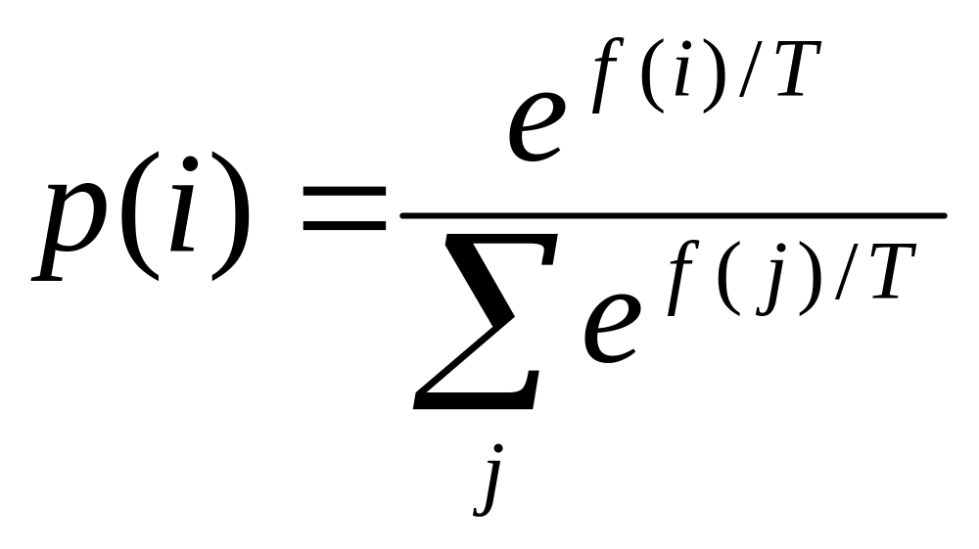
Boltzmann Distribution
Used to probabilistically select which individuals to crossover
  f(i) : fitness function
  T : Temperature
    Chosen by designer

Slide 15
Classification
One of the main functions of a machine learning algorithm is classification
The agent is presented with a bit string and asked to classify it between two or more classifications
A pattern which will classify all bit strings is called a hypothesis

Slide 16
PlayTennis
Day | Outlook | Temp | Humidity | Wind | Play
D1 | Sunny | Hot | High | Weak | No
D2 | Sunny | Hot | High | Strong | No
D3 | Overcast | Hot | High | Weak | Yes
D4 | Rain | Mild | High | Weak | Yes
D5 | Rain | Cool | Normal | Weak | Yes
D6 | Rain | Cool | Normal | Strong | No
D7 | Overcast | Cool | Normal | Strong | Yes
D8 | Sunny | Mild | High | Weak | No
D9 | Sunny | Cool | Normal | Weak | Yes
D10 | Rain | Mild | Normal | Weak | Yes
D11 | Sunny | Mild | Normal | Strong | Yes
D12 | Overcast | Mild | High | Strong | Yes
D13 | Overcast | Hot | Normal | Weak | Yes
D14 | Rain | Mild | High | Strong | No

Slide 17
Classification and
Machine Learning
What rule or set of rules can you make up that fits the data.
This is what is known as Machine Learning
  Looking at Data
  Trying to Classify that Data using made up rules
  Seeing if those rules generalize to data sets that have not yet been seen

Slide 18
Hypothesis Representation
Hypothesis are often represented by bit-strings.
Each bit in the string has an interpretation associated with it.
For example a bit in the string could represent a possible classification
It is good to ensure that all possible bit patterns have meaning

Slide 19
Classification and
Genetic Algorithms
Genetic Algorithms can be used for classification
The trick is to come up with a representation of a candidate rule that can be used in a G.A.
Then a whole population of rules (bit-strings) can be randomly generated until one bit string can classify all of the training examples.

Slide 20
Hypothesis Representation
Example
Each bit corresponds to a possible value of the attribute
A value of 1 indicates the attribute is allowed that value
Outlook Wind PlayTennis
011 10 10
Corresponds to if wind = Strong and Outlook = Overcast or Rain

Slide 21
Hypothesis Evaluation
This is relatively easy
Just count the number of training examples that the hypothesis correctly classifies
  You might also include a measure that describes how simple a rule is
  Simpler rules often have better generalization performance

Slide 22
Putting it all together
Once you have your hypotheses representation and your fitness function
You can apply normal techniques of G.A.s
  Selection
  Mutation
  Crossover
Until your population converges to a good Result

Slide 23
Problems with GA’s
Pre-mature convergence
  Often if your algorithm is not balanced it will prematurely converge to an unacceptable hypothesis.
  Culprit is often your selection function
  Could often be your
    fitness function
    Hypothesis representation

Slide 24
GENETIC PROGRAMMING
Using genetic algorithms to produce computer programs

Slide 25
Genetic Programming
Individuals are programs
Represented by Trees
  Nodes in the tree represent function calls
  User supplies
    Primitive functions
    Terminals
  Allows for arbitrary length

Slide 26
Genetic Programming
Crossover
  Crossover points chosen randomly
  Done by exchanging sub-trees
Mutation
  Not always necessary
  Randomly change a node

Slide 27
Genetic Programming
Search through space of programs
Other search methods also work
  Hill climbing
  Simulated annealing
Not likely to be effective for large programs
  Search space much too large

Slide 28
Genetic Programming
Variations
  Individuals are programs
  Individuals are neural networks
    Back-propagation
    RBF-networks
  Individuals are reinforcement learning agents
    construct policy by genetic operations
    could be aided by actual reinforcement learning

Slide 29
Genetic Programming
Smart variations
  Hill-climbing mutation
  Smart crossover
    requires a localized evaluation function
    extra domain knowledge required

Slide 30
Genetic Programming Applications
Block Stacking Koza (1992)
  Spell “universal”
  Operators
    (MS x) move to stack
    (MT x) move to table
    (EQ x y) T if x = y
    (Not x)
    (DU x y) do x until y

Slide 31
Genetic Programming Applications
Block stacking continued
  Terminal arguments
    CS (Current Stack)
    TB (top correct block)
    NN (next necessary)
  Final discovered program
    (EQ (DU (MT CS)(Not CS))(DU (MS NN)(NOT NN)) )

Slide 32
Genetic Programming Applications
Circuit Design (Koza et al 1996)
Gene represents potential circuit
Simulated with Spice
Population of 640,000
64 node parallel processor
98% of circuits invalid first generation
Good circuit after 137 generations

Slide 33
Genetic Algorithms
Relationships to other search techniques
  Mutation is a blind “hill climbing” search
    mostly to get out of local minima
  Selection is just hill climbing
  Crossover is unique
    no obvious corollary other search techniques
    the source of power for genetic algorithms

Slide 34
Evolution and Learning
Lamarckian Evolution
  Proposed that learned traits could be passed on to succeeding generations
  Proved false for biology
  Works for genetic algorithms

Slide 35
Evolution and Learning
Baldwin Effect
  Learning individuals perform better
  Rely less on hard coded traits
  Allows a more diverse gene pool
  Indirectly accelerates adaptation
  Hinton and Nowlan 1987
    Early generations had more learning than later

Slide 36
Evolution and Learning
Baldwin effect alters inductive bias
  hard coded weights restricts learning
  good hard coded weights allow faster learning
Nature vs Nurture
  Humans have greater learning
  Require shaping
    learn simple things before complex things

Slide 37
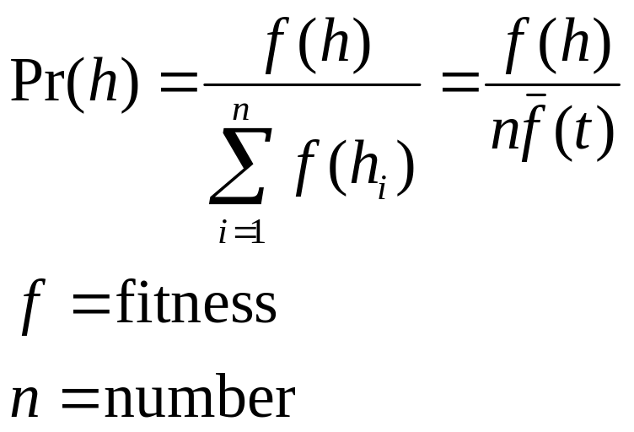
Schema Theorem
Probability of selecting a hypothesis.

Slide 38
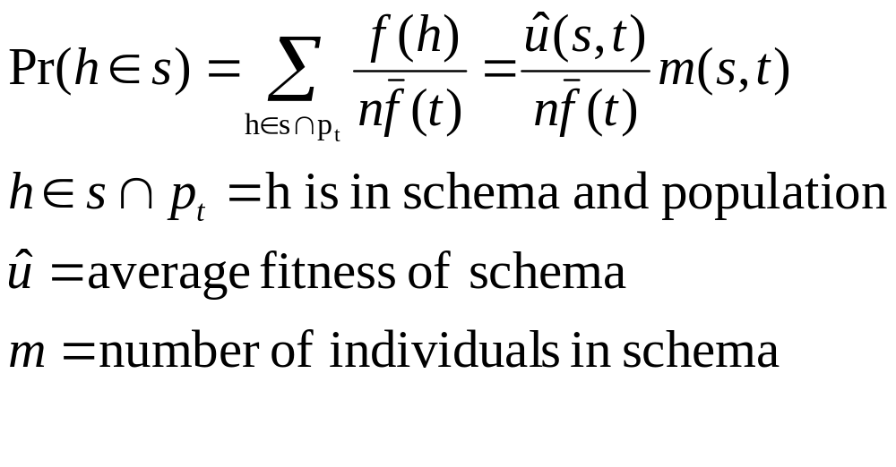
Schema Theorem
Probability of selecting a schema

Slide 39
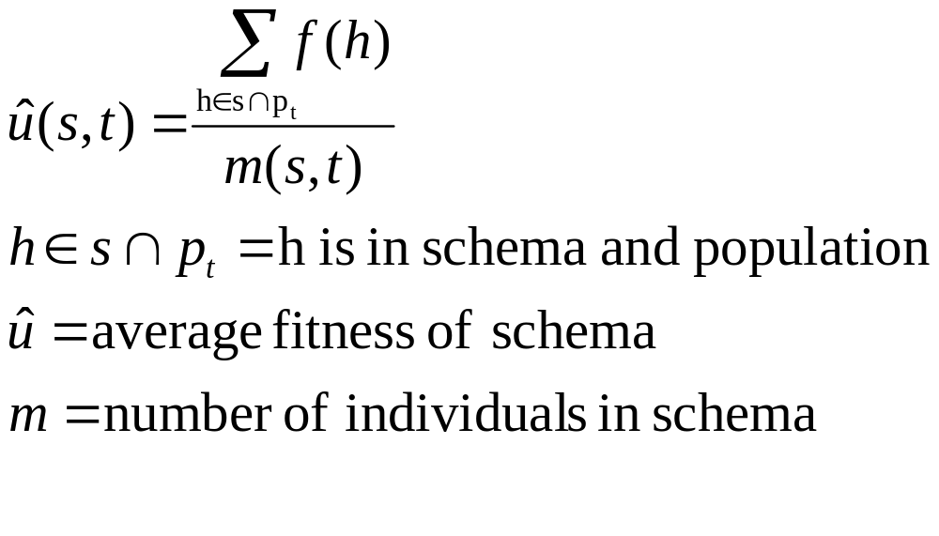
Schema Theorem
Equation for average fitness of schema

Slide 40
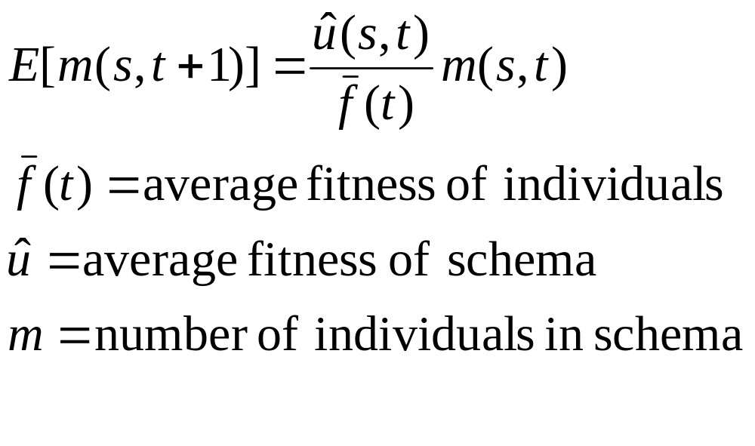
Schema Theorem
Expected number of members
of schema s

Slide 41
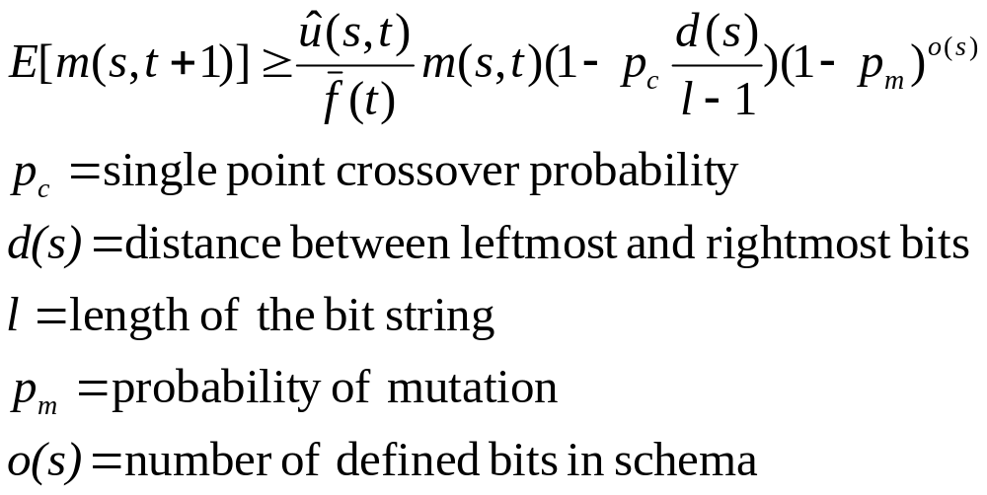
Schema Theorem
Full schema theorem

